Slide 1
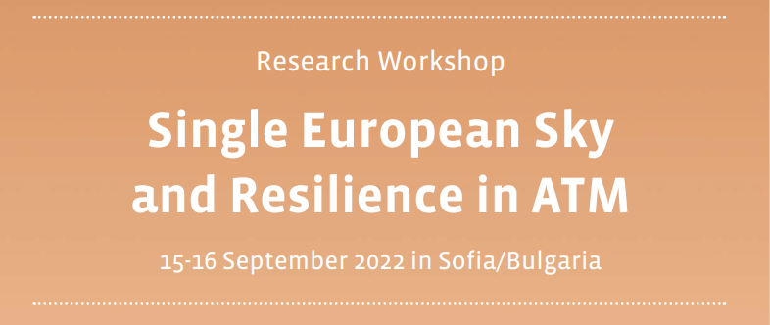
Single European Sky and Resilience in ATM – can this be a ‘win-win’ for the aviation industry?
The IFATCA input
Frederic Deleau, Executive Vice-President Europe
Dr. Stathis Malakis, Member of the JCHMS of IFATCA

Slide 2
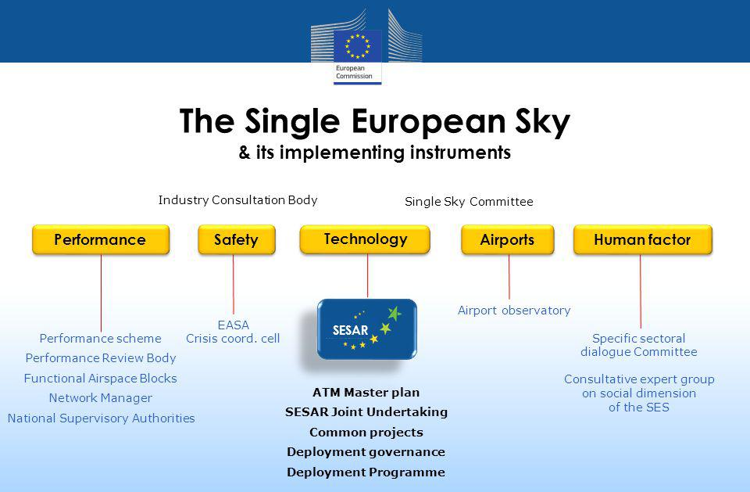
SES – SESAR – PRB and Performance Scheme
SES legislation introduced a Performance Scheme which defines mandatory performance targets for the ANSPs of EU Member States.
The PRB advises and supports the Commission in setting up binding performance targets and thereby, in a way, acts as the regulator for ATM at the European level.
In this sense, in the European ATM system, resilience and sustained adaptability are considered to be defined by the scope of the SES Performance Scheme.

Slide 3
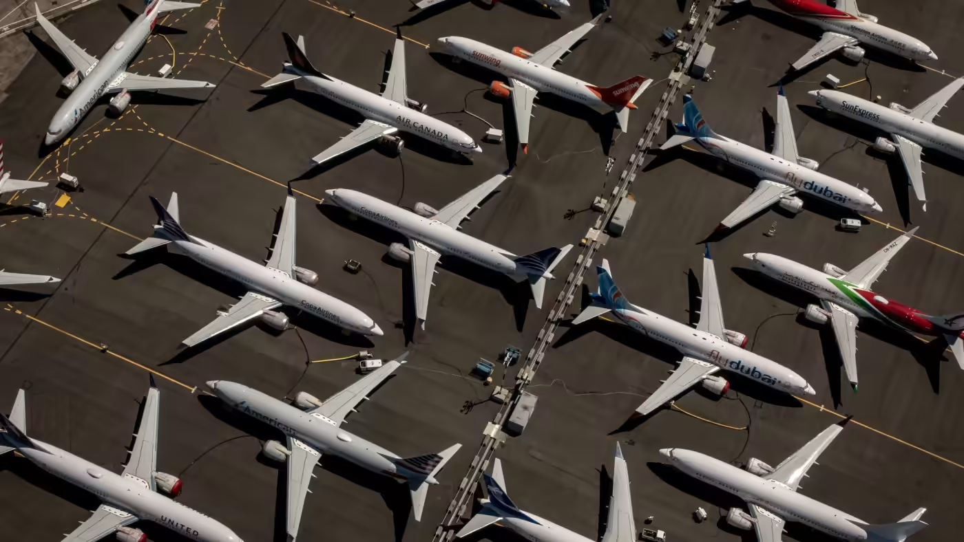
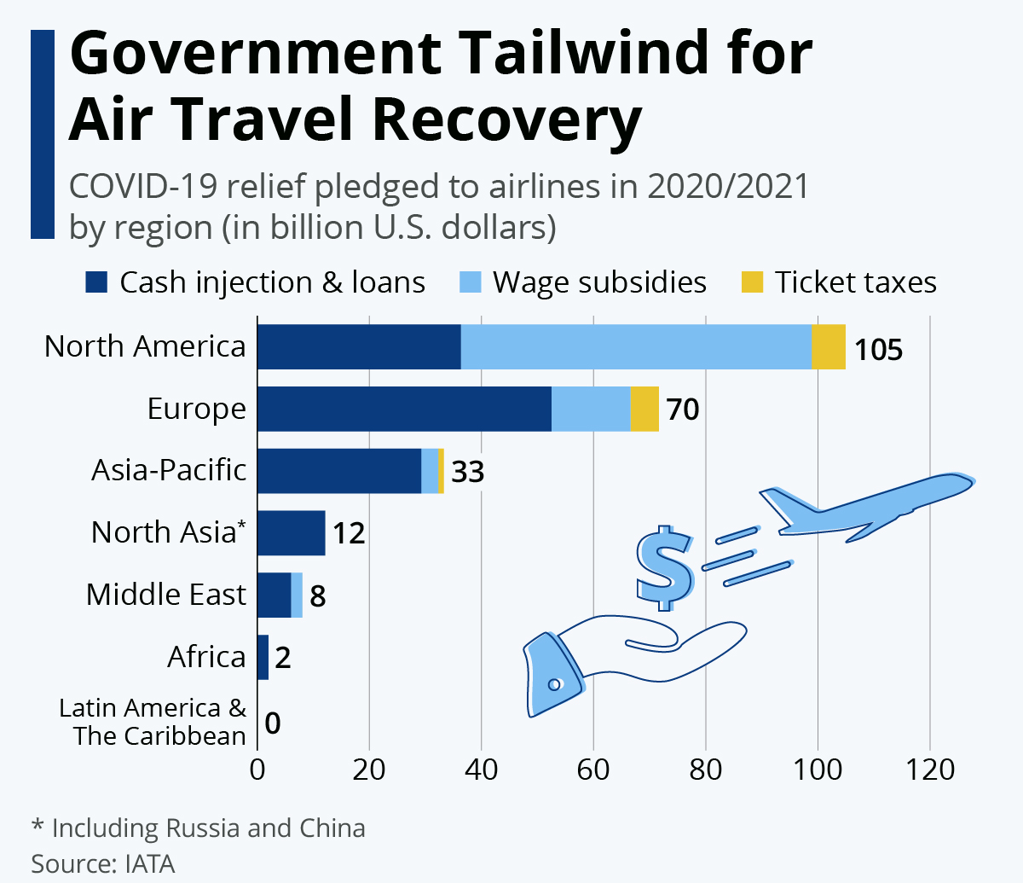
Covid -19 Pandemic and Aviation

Slide 4
War on Ukraine and Aviation

Slide 5

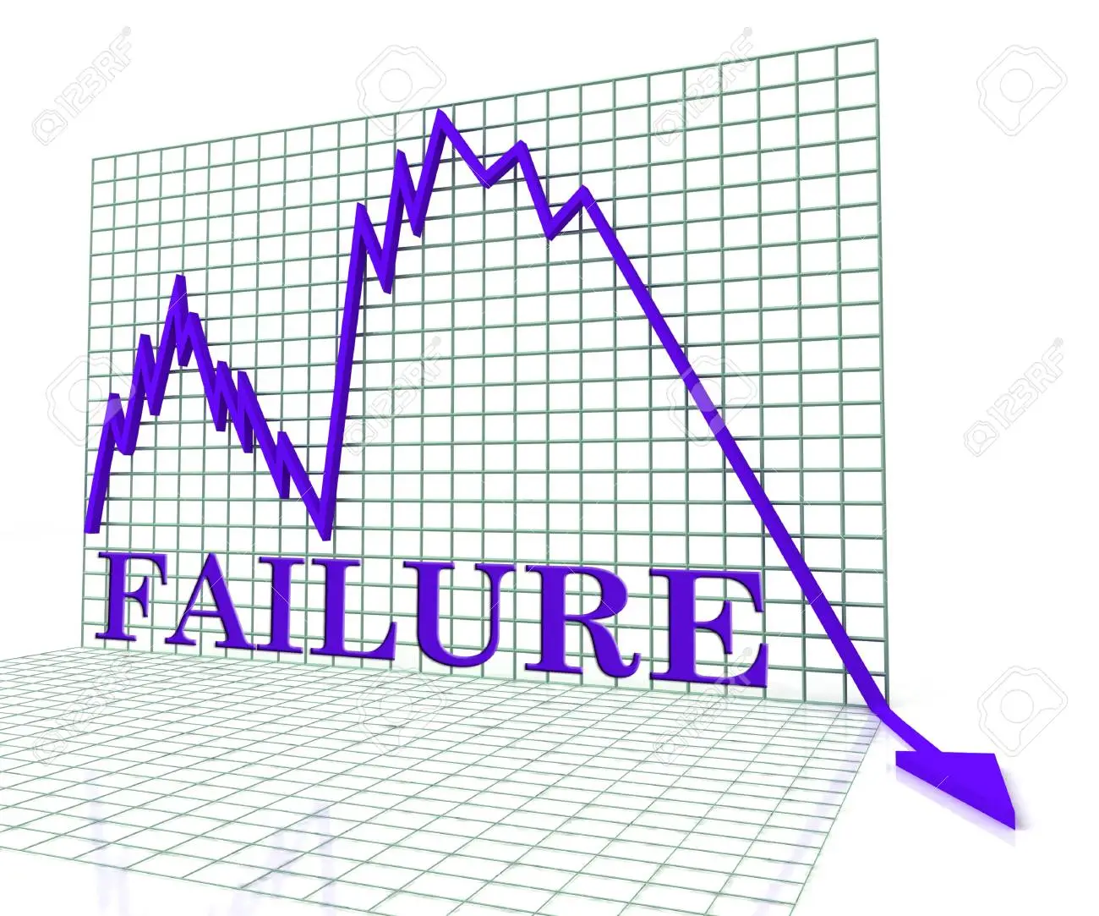
What Covid -19 Pandemic Demonstrated
Forecasting and charging scheme deficiencies can produce results that provide a false reassurance about the degree of financial stability of the ANSPs.
SES has a large share of responsibility in institutionalizing the financial and performance fragility of the European ANSPs.

Slide 6


IFATCA’s Position
IFATCA contends that:
  The performance scheme has been proven to reduce the ANSPS ability to maintain resilient performance.
  The charging system has reduced the ANSPS ability to sustain resilient performance.
  That the philosophy of SESAR and SES has reduced the ANSPS ability to maintain resilient performance.

Slide 7

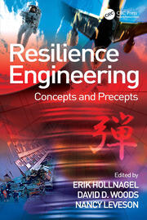

Resilience Engineering Paradigm and key Definitions
Resilience is defined as the ability to succeed under varying conditions, so that the number of intended and acceptable outcomes is as high as possible.
Sustained Adaptability refers to the ability to continue to adapt to changing environments, stakeholders, demands, contexts, and constraints.

Slide 8
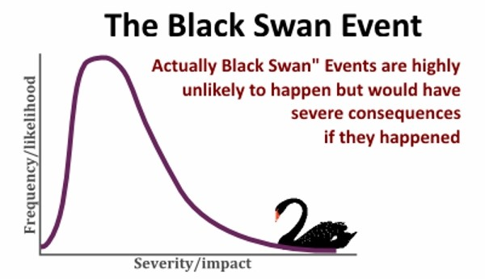
Crisis preparedness, response and recovery and Black Swan Events
Crisis preparedness, response and recovery remain amongst the most challenging problems facing organizations because of their :
  large social and economic costs in their management and
  limited organizational learning from previous crisis.
Much of the history of the Covid-19 crisis in the aviation domain can be interpreted broadly as an underestimation of risks, not only of the probability of Black Swans but also, of the distinctive ANSPs’ financial fragility to them.

Slide 9
The four potentials of Resilience
Timeline
Respond to regular and irregular disruptions by adjusting normal functioning
Learn the right lessons from experience
Monitor events and actions that could become threats in the near term as well as monitor one’s own performance
Anticipate developments and threats further into the future, (potential disruptions, pressures, and consequences)
Knowing
what to do
Knowing
what to look for
Knowing
what to expect
Knowing
what has happened

Slide 10
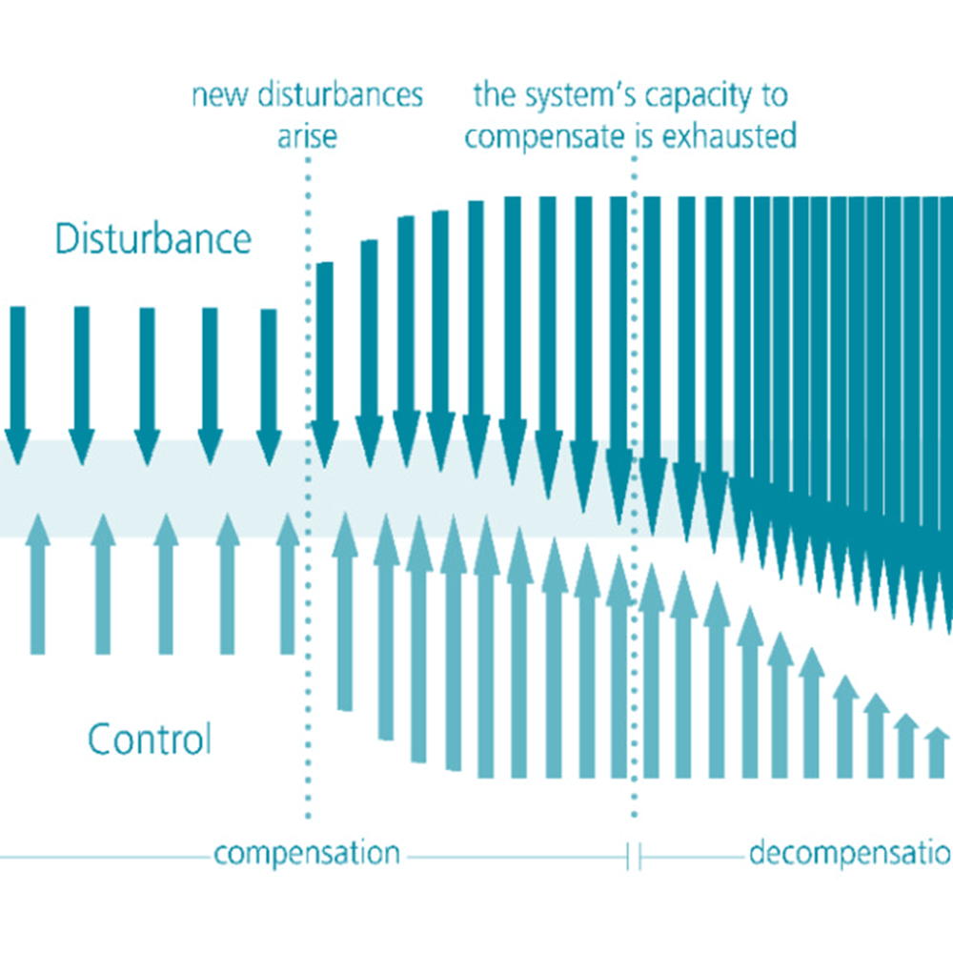


Three patterns of adaptive breakdown
Complexities in time Decompensation
Complexities over scales Working at cross-purposes
Complexities in learning Getting stuck in outdated behaviors

Slide 11
A framework of possible solutions to counteract financial and performance fragility
Increased Personnel Redundancy
Introduction of Stress Tests
Moving Away from Uninformative Safety, Financial and Performance Indicators
Restructuring of the ATFCM system
Cultivating Adaptive Diversity
Tap local knowledge

Slide 12
Environmental performance as the overarching SES target
In IFATCA's view there is a unique opportunity to adjust the ATM sector's performance to the environmental challenges.
This can be achieved by establishing an RP4 performance scheme which puts the environmental performance as the interdependency performance target which is currently lacking in the performance scheme.
Safety
Capacity
Environment Performance
Cost Efficiency

Slide 13
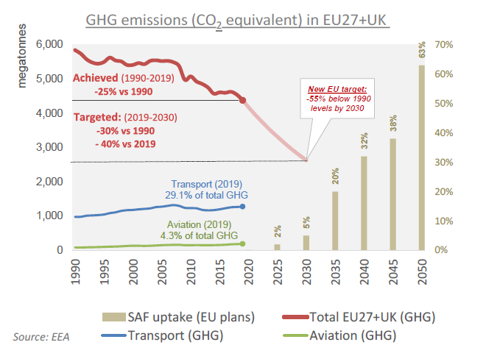
EU Fit for 55
Reduce GHG emissions to at least 55% below 1990 figures.
For transport, it calls for a 90% reduction in GHG emissions by 2050 compared to 1990 levels, while working towards a zero-pollution ambition.

Slide 14
4 pillars
Aircraft technology (airframes and engines).
Sustainable aviation fuels (SAF).
Market based measures (MBM
Improved infrastructure and operations (operational efficiency).

Slide 15

Improved infrastructure and operations including operational efficiency
ATM infrastructure (non operational)
  Energy, IT, building, travel
  Reduce to zero net operation
    Commuting of Staff
    Offsetting the IT energy consumption
    Solarpanel and Wind energy for remote sites
ATM operations
  Free Route airspace
  Horizontal Flight Efficiency
  Vertical Flight Efficiency
  Noise abattment procedure
  Taxi out time
  Continuous Climb/Descent
  Availability of the infrastructure
Environment case
Notes:
• An environment case is a documented body of evidence that provides argument that a certain procedure is optimised for all individual environmental factors as prioritised by the appropriate authorities.
• An environment case should provide a detailed overview to the appropriate authorities for the determination of priorities of the individual environmental factors on a strategic level.

Slide 16
Environment and Aviation Industry
Environment
Noise Abatement
Local Air Quality
Aviation Industry
Safety
Capacity
Ensure that the level of safety shall be maintained or improved when environmentally-driven procedures are introduced;
Ensure that all individual environmental factors are identified and considered while establishing procedures;
The actual values (noise levels, fuel consumption and the level of emissions) of the various individual environmental contributors of new or existing procedures should be established in detail for transparency purpose;
The interrelation of the various individual environmental factors should be identified and addressed.
Emissions
Notes:
• An environment case is a documented body of evidence that provides argument that a certain procedure is optimised for all individual environmental factors as prioritised by the appropriate authorities.
• An environment case should provide a detailed overview to the appropriate authorities for the determination of priorities of the individual environmental factors on a strategic level.

Slide 17
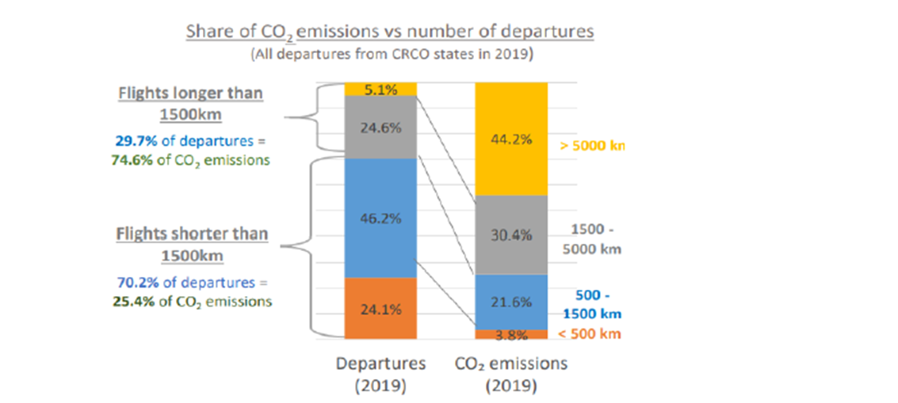
Some thoughts
NM Role
Owner of the ATM ENV budget.
Trajectories as a total and not individual ATC unit.
Start with the flights above 1500 Km or 5000Km.
First come first served?

Slide 18
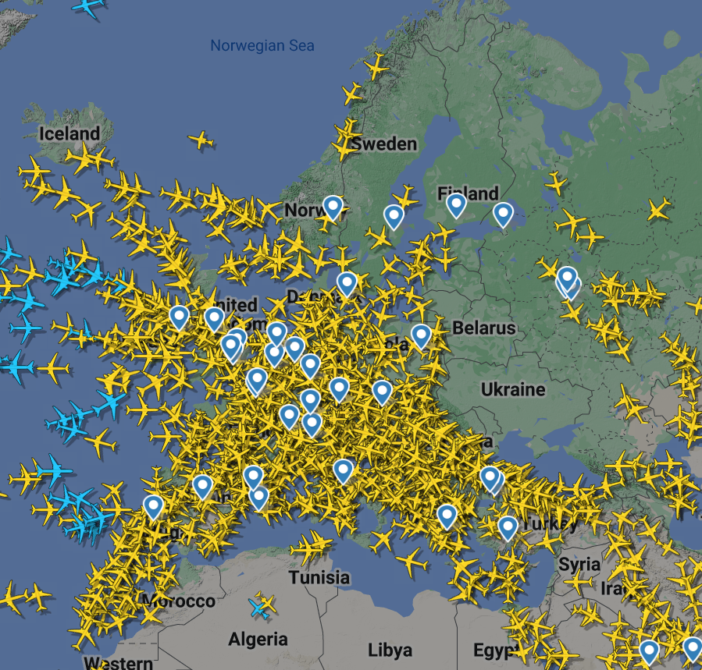


More thoughts

Slide 19

Conclusions
We argued that SES has a large share of responsibility in institutionalizing financial and performance fragility to the European ANSPs.
We provided a framework of possible solutions to counteract financial and performance fragility.
We stressed the importance of reframing the SES Environment performance indicator to embrace the interdependencies between several performance areas.
By creating a systemic approach to manage the ATM contribution to decarbonization IFATCA claims that this could be a win- win situation.

